Slide 1


The Ruby Programming Language
Developed by:
André Oliveira 107637
Duarte Cruz 107359 Group 1 CSLP
Hugo Correia 108215

Slide 2
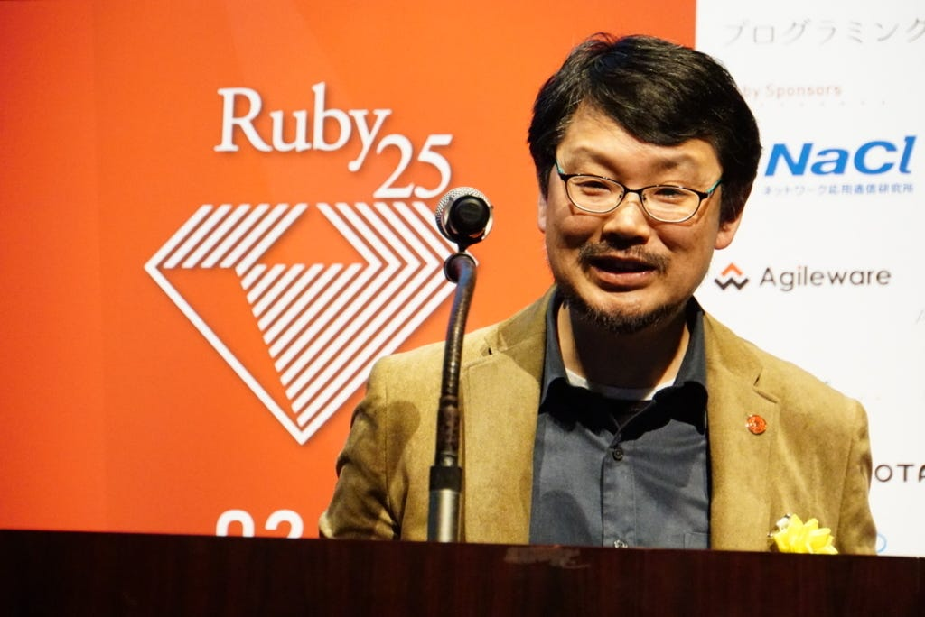
What is Ruby?
Ruby is a dynamic, open-source programming language that focuses on simplicity and productivity.
It was created by Yukihiro “Matz” Matsumoto, blending elements of his favorite languages to form a new language that balanced functional programming with imperative programming.
Matz aimed to make Ruby natural, not simple, in a way that mirrors life.
Design Philosophy:
Focus on programmer happiness
Balance between simplicity and productivity
Suitable for both beginners and experienced developers
"Trying to make Ruby natural, not simple," - Matz

Slide 3

Purpose and Use-Cases
Web Development
Ruby on Rails, an opinionated web framework, powers popular platforms like GitHub, Shopify, Airbnb, and Twitch.
Scripting and Automation
Used as a "glue" language for tools like Vagrant, Chef, Puppet, and Homebrew.
Prototyping and Data Analysis
Suited for prototyping and data analysis tools like Jupyter, Metasploit, Cucumber, and Sass.

Slide 4
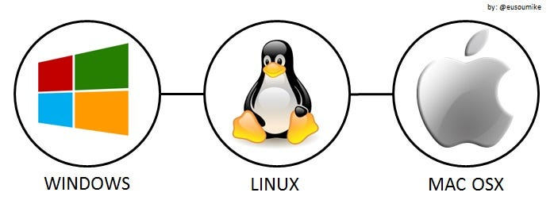
Strengths
Readability and Writability
Intuitive syntax, mirroring natural language
Appeals to new programmers
Flexibility and Productivity
Dynamic typing and duck typing
Concise and expressive code
Community and Support and Ecosystem
Large developer community
Abundant libraries and tools
Popular in web development
Portability and Compatibility
Available on Windows, macOS, Linux, and BSD
Compatible with C, C++, Java, Python, and Perl

Slide 5
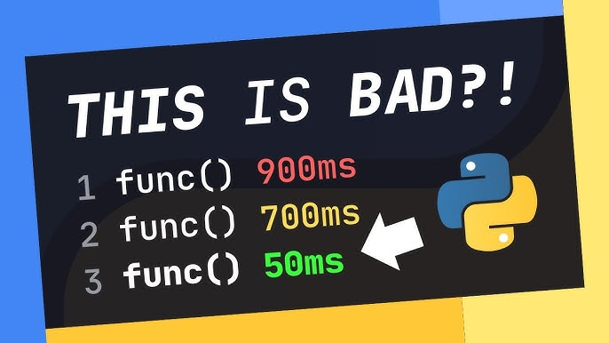

Weaknesses
Performance
Slower execution compared to C++ or Java
Scalability and Concurrency
Challenges in managing multithreading effectively
Memory Usage
Less efficient memory management
Type Safety
Dynamic typing may lead to runtime errors
Ecosystem and Dependency Management
Complex dependency management

Slide 6

Memory Management and Garbage Collection
Garbage Collector
Generational GC, Incremental GC, Memory Compaction
Memory Usage
Historical criticism for higher usage
Improvements in Ruby 3 for efficiency
Development practices for efficiency
Memory Management
Automation with GC
Often seen as less efficient, leading to higher memory usage
Manual interventions when needed
Monitoring and diagnostics in Ruby 3

Slide 7
Programming Paradigms
Object-Oriented
Everything is an object
Supports inheritance, polymorphism, encapsulation
Functional
Features from functional languages
Supports first-class functions and closures
Imperative
Uses statements to change program state
Supports loops and conditionals
Procedural
Supports procedural programming
Reflective
Metaprogramming for manipulating structure at runtime
Reflection for object inspection
Metaprogramming
Treating programs as data
Scripting
Used for task automation and interaction with the OS

Slide 8
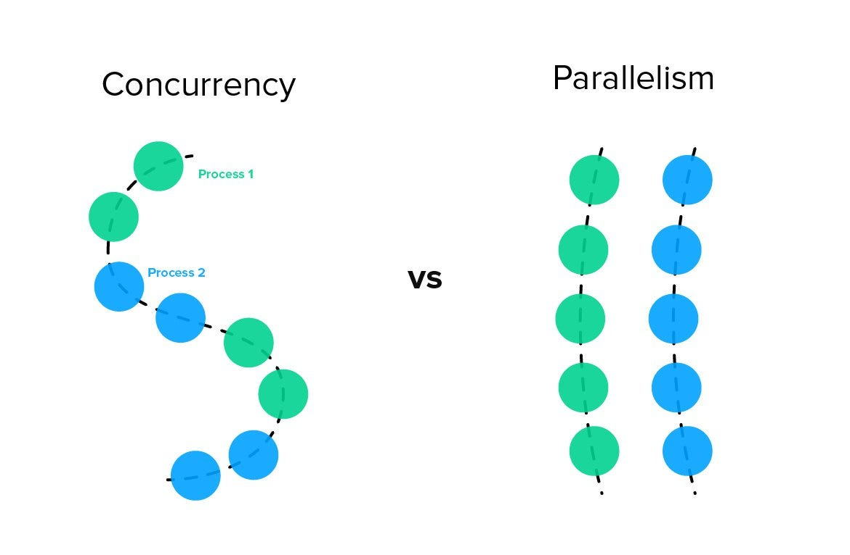
Parallelism and Concurrency
Concurrency
Threads and fibers for concurrent execution
GIL limits native thread execution
Parallelism
Challenges due to GIL
Achievable through processes (e.g., with the parallel gem)
Alternative implementations (JRuby, Rubinius) for true parallelism

Slide 9
The future of Ruby
Matz’s Vision and Ruby 3x3
Three times faster by Ruby 3
JIT compilation in MRI
Ractor for Concurrency
Actor-like concurrency abstraction
Type Checking and Sorbet
Static type checker for Ruby
Guilds for Parallelism
Proposed for true parallelism
Active Development of Frameworks and Gems
Continuous evolution of Ruby on Rails and other frameworks
Community Engagement and Conferences
RubyConf, RailsConf shaping the language's future
Emerging Trends and Integration
Integrating machine learning, AI, and serverless computing

